Slide 1
Visualization libraries updates. ParaView usage on Piz Daint
Jean M. Favre, CSCS
October 18th 2018
Notes:
1

Slide 2
Motivating facts I
Piz Daint is split into two partitions
GPU
Multi-core
On a GPU node
Memory is strictly limited to 16GB
PCI bus stands between CPU and GPU
Strongly restrict the size of data that can be rendered in-core
On an MC node
Some nodes are fatter (128 GB)
More hardware threads (2x18 with hyperthreading = > 72 threads)

Slide 3
Motivating facts II
Some users only have an allocation on the MultiCore partition
Can we provide ParaView for ALL users, regardless of their allocation?
Questions
Is performance up to par?
Is it worth it?
Does it enable new ways to do visualization?

Slide 4
Motivating facts III
GPUs are synonymous with OpenGL rendering
But traditional OpenGL limits both the shading models and the type of geometry that can be rendered
Tesselation leads to an explosion in triangle counts
OpenGL-based rasterization cannot handle implicit isosurfaces, particles, streamlines or advanced shading (soft shadows, Ambient Occlusion, Global illumination, etc.)

Slide 5
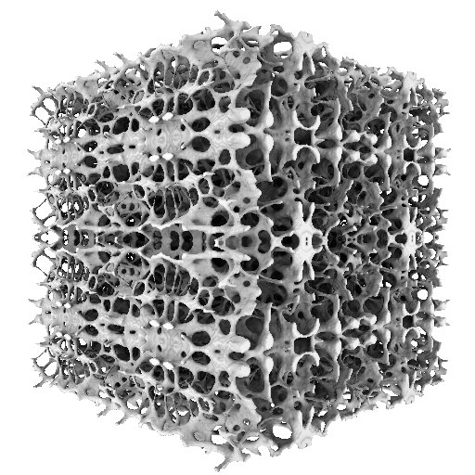
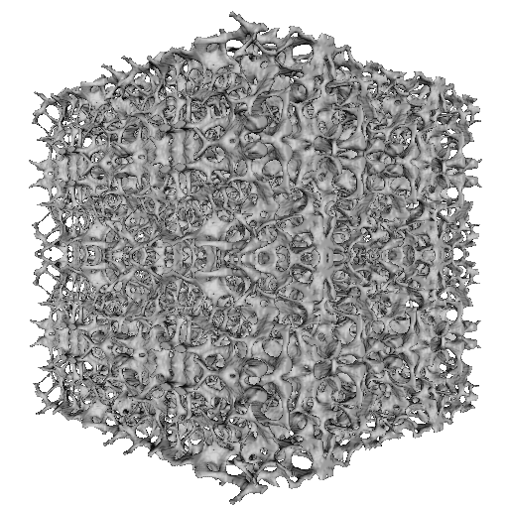
Ambient Light Occlusion
Notes:
5

Slide 6
Motivating facts IV
Parallel (distributed data) is the standard paradigm of ParaView
It uses the so-called sort-last image compositing
Illustration…

Slide 7
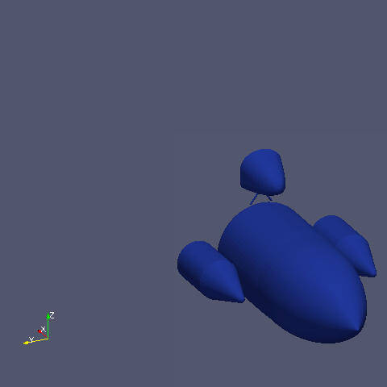
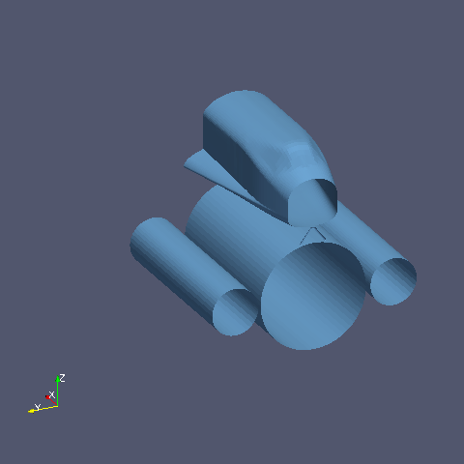
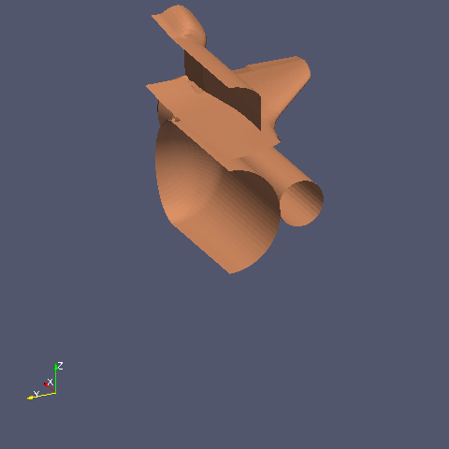
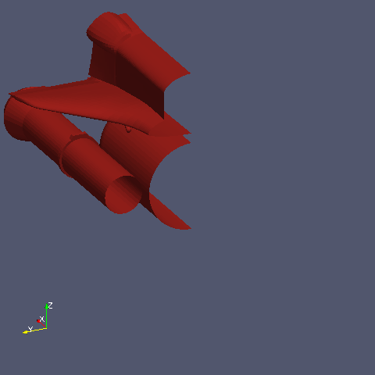
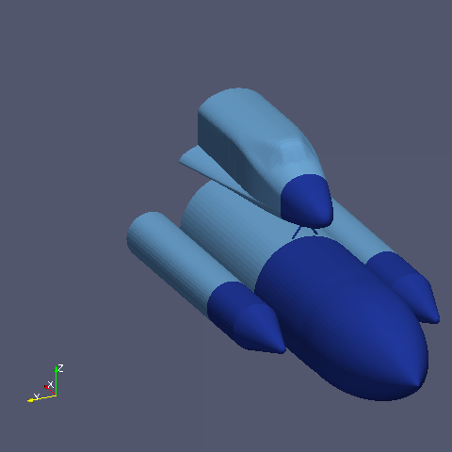
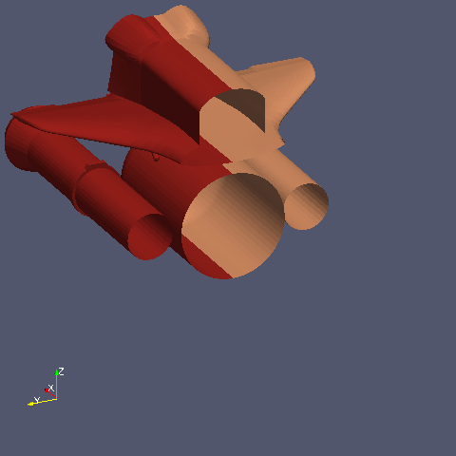
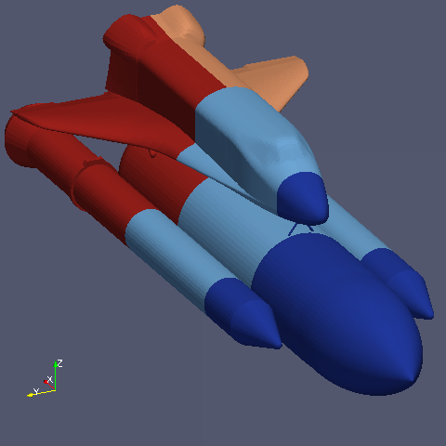
Sort-last image compositing

Slide 8
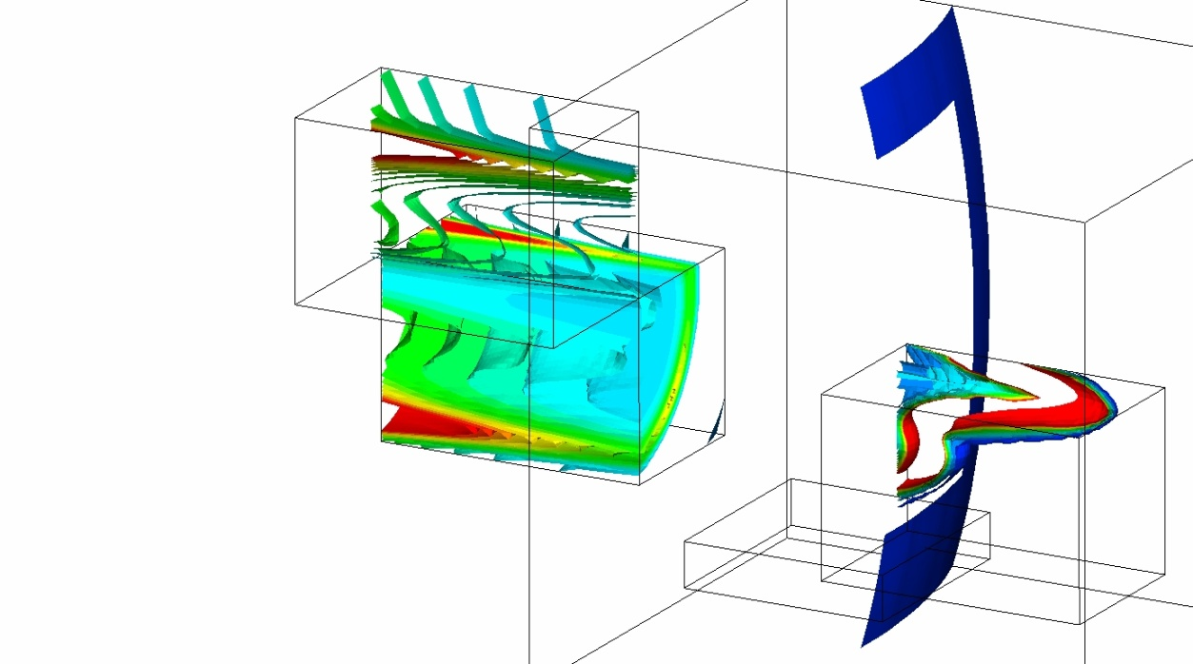
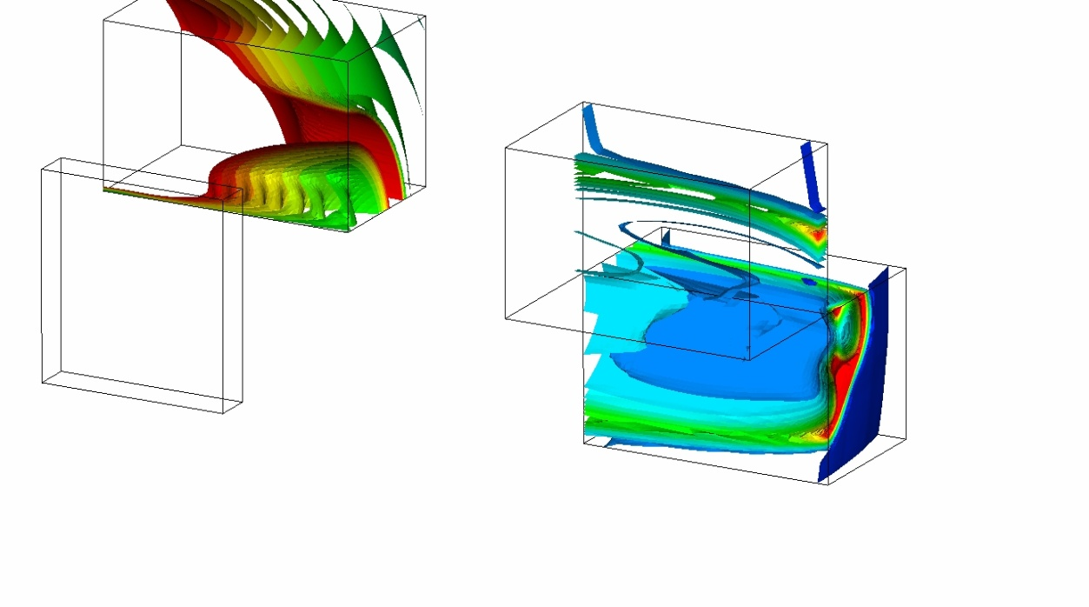
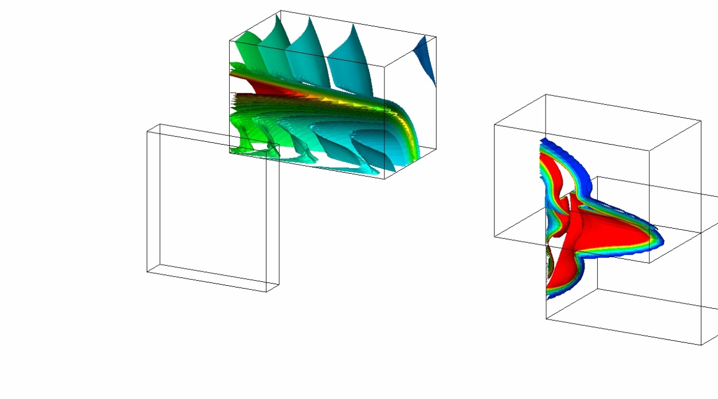
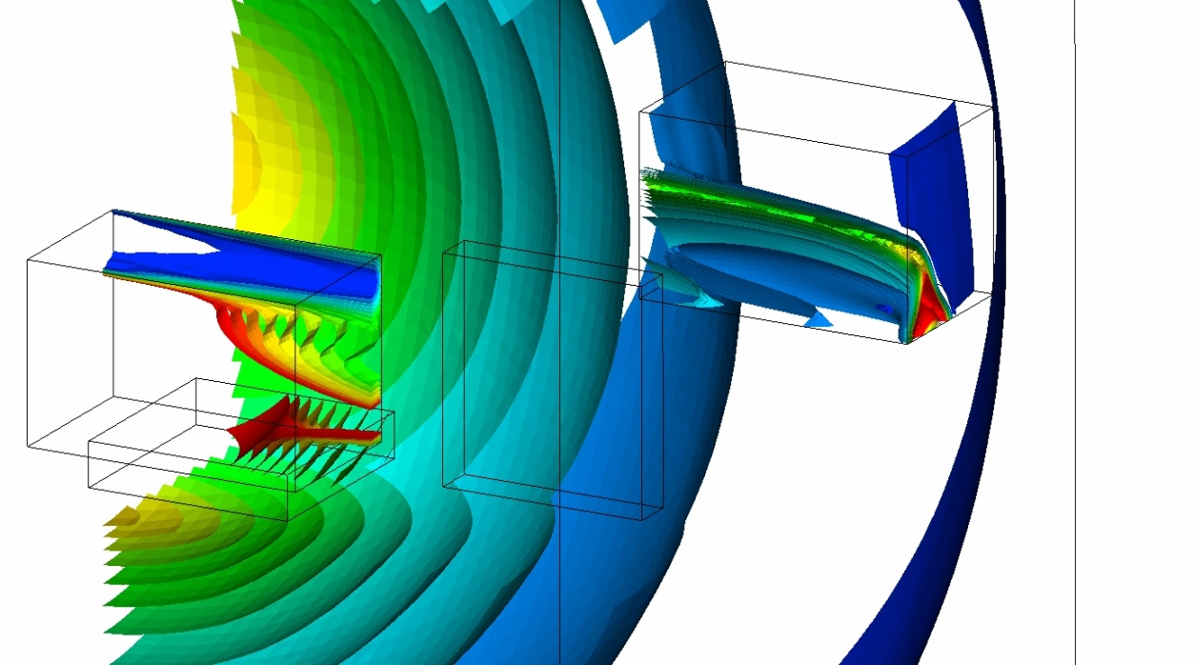
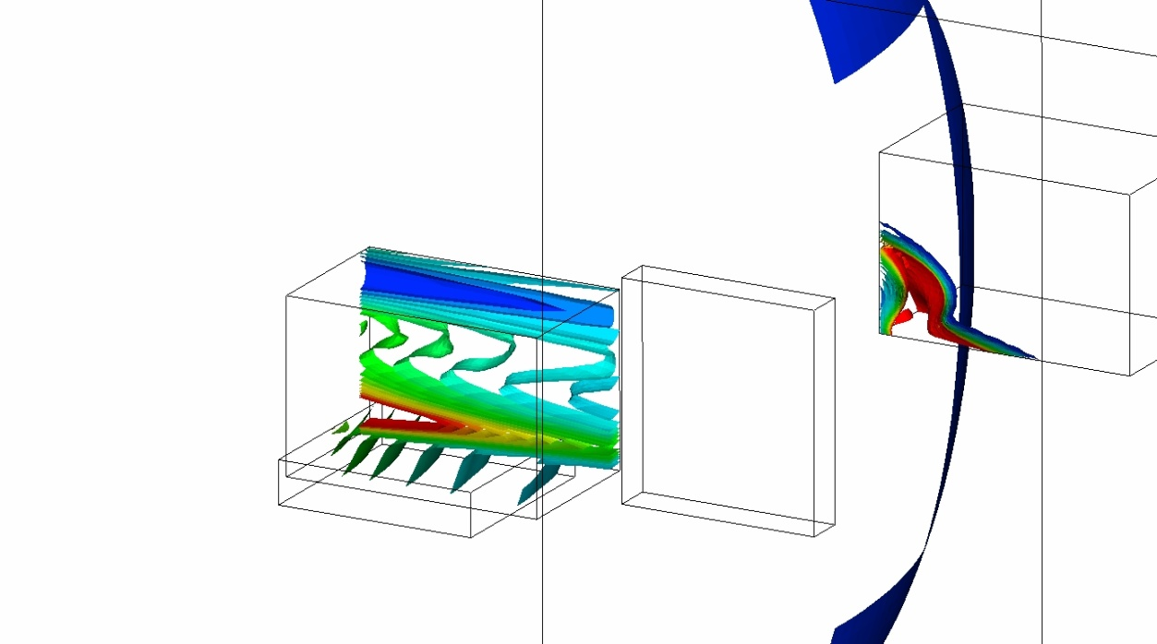
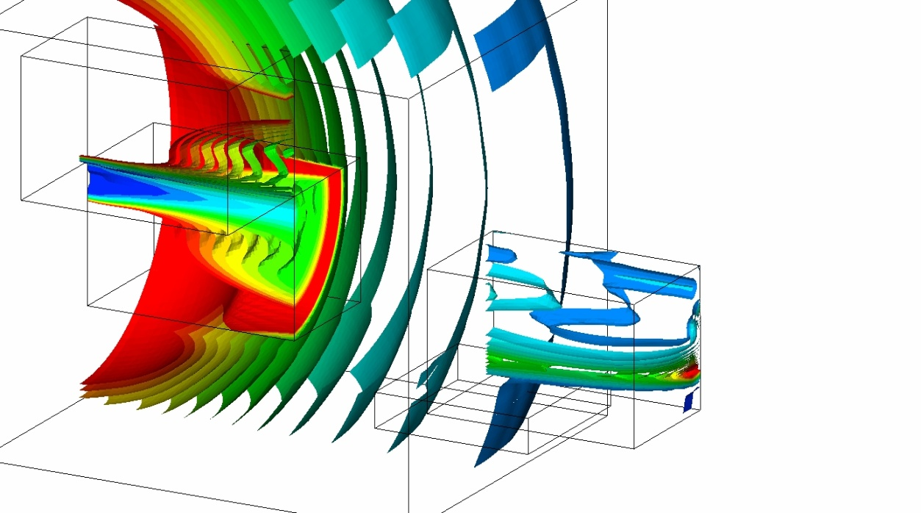
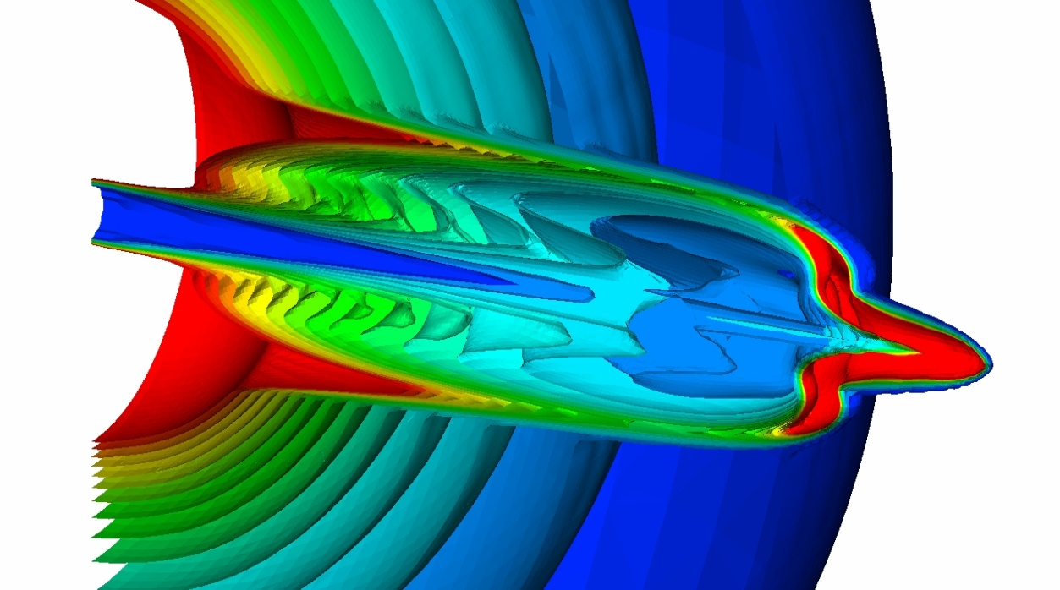
Arbitrary 3-D data partitioning
Is the final image order-independent?
A sort-last compositing enables complete freedom in data partitioning for opaque geometries

Slide 9
These examples are where the classic OpenGL support shows its limits
Global illumination needs global data access
Sort-last alpha-compositing is problematic for a ray-tracer since it does not work for arbitrary secondary rays.

Slide 10
The hardware and compiler technology have evolved
It is also time for us to embrace the new technologies
EGL
LLVM-enabled Mesa
TBB-based OSPRay
NVIDIA IndeX
NVIDIA OptiX

Slide 11
Libs use for ParaView
EGL
we no longer need an X-server windowing system
Adopted on Piz Daint since NVIDIA driver 352
Mesa, an open-source implementation of OpenGL
A variety of device drivers allows the Mesa libraries to be used in many different environments ranging from software emulation to complete hardware acceleration for modern GPUs.
LLVM
modern source- and target-independent optimizer, along with code generation support for many popular CPUs
The Mesa Gallium multithreaded llvmpipe driver is used for ParaView for the Multi-core partition
a software rasterizer that uses LLVM to do runtime code generation. Shaders, rasterization and vertex processing are implemented with LLVM, translated to x86-64 machine code.

Slide 12
Performance?
Demo 1
Rendering lib | Small (8.8 M tris) | Big (257 M tris)
OpenGL | 10-12 frames/sec | 6 frames/sec
LLVM-Mesa | 2-3 frames/sec | 2-3 frames/sec
TBB-OSPRay

Slide 13
Improved visual appearance was provided…
But still without global illumination effects
Enable OSPRay and ray-tracing
#SBATCH --cpus-per-task=72
#SBATCH --ntasks-per-core=2
#SBATCH --constraint=mc

Slide 14
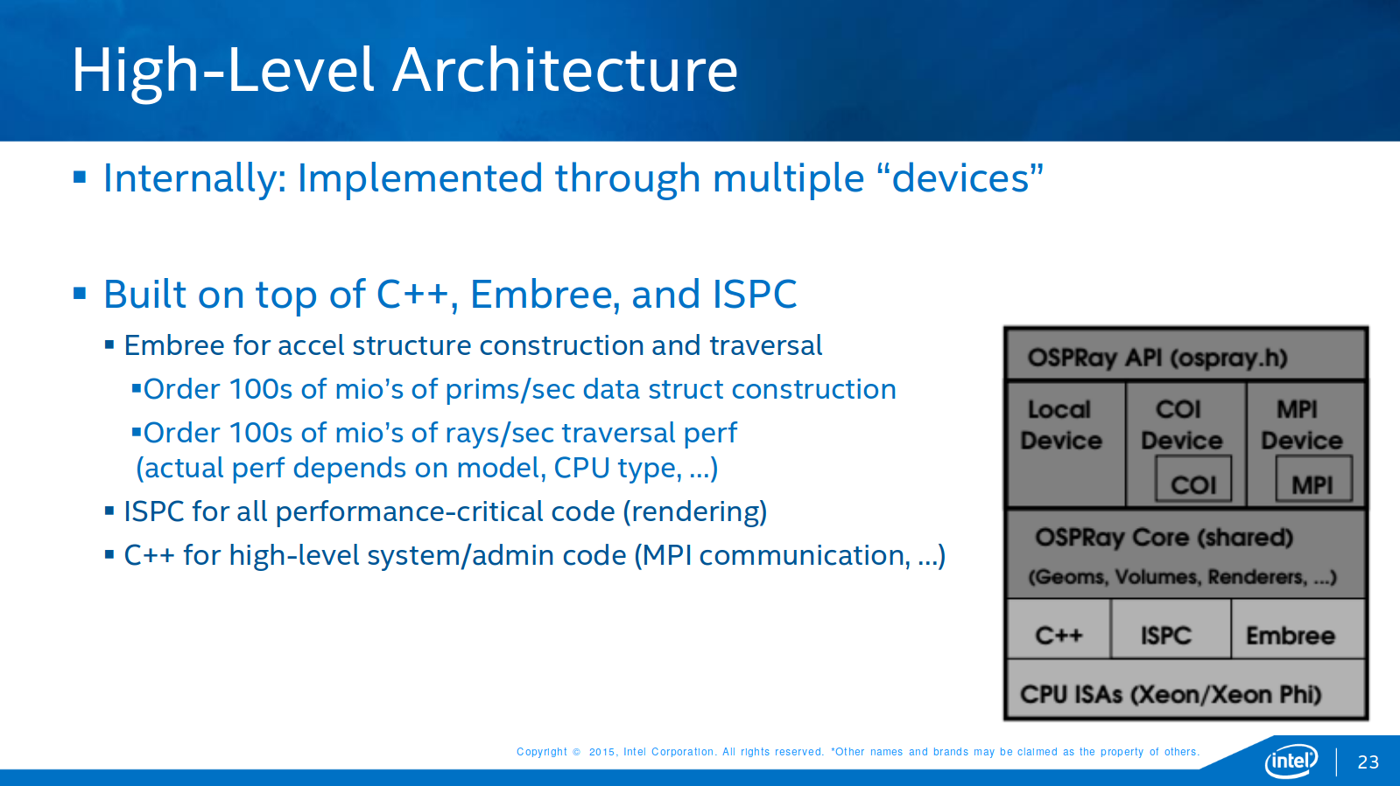

Slide 15
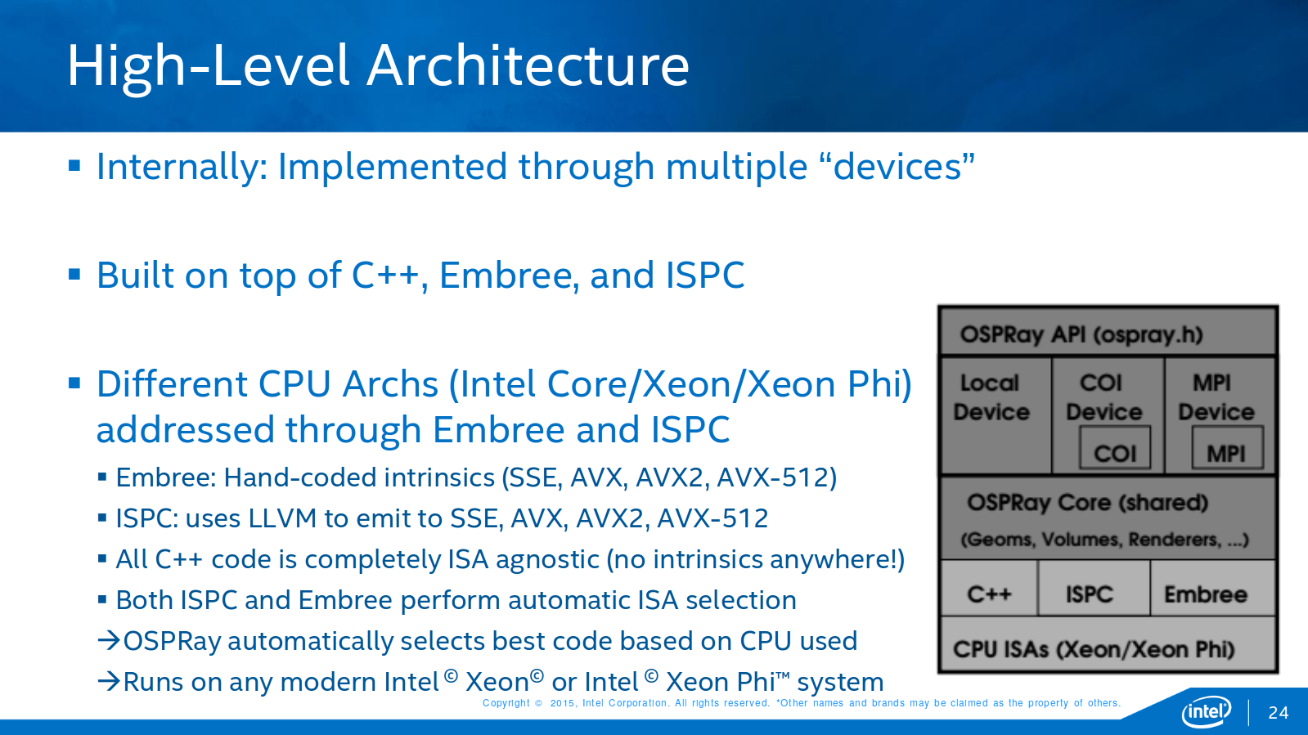

Slide 16
Performance?
Demo 2
Rendering lib | Small (8.8 M tris) | Big (257 M tris)
OpenGL | 10-12 frames/sec | 6 frames/sec
LLVM-Mesa | 2-3 frames/sec | 1-2 frames/sec
TBB-OSPRay | 9-11 frames/sec | 9-10 frames/sec
TBB-OSPRay + shadows | 9-11 frames/sec | 9-10 frames/sec

Slide 17
ParaView runs with headless rendering on Piz Daint
Headless rendering
On the server side, there is no need to open a graphics window to do rendering => No need for an X-server running on the compute nodes
GPU-accelerated rendering
OpenGL on NVIDIA hardware with EGL
OSMesa rendering
off-screen Mesa on the multi-core CPU

Slide 18
Coming soon
Ray-tracing also supported by the NVIDIA OptiX lib
VTK integrates support for OptiX
As of October 2018, there is no GUI for it…but it’s coming
I have worked with NVIDIA to test the OptiX port to ParaView
NVIDIA has announced the Turing GPU
Turing brings together dedicated hardware acceleration of four core elements: AI, ray tracing, programmable shading and simulation.

Slide 19
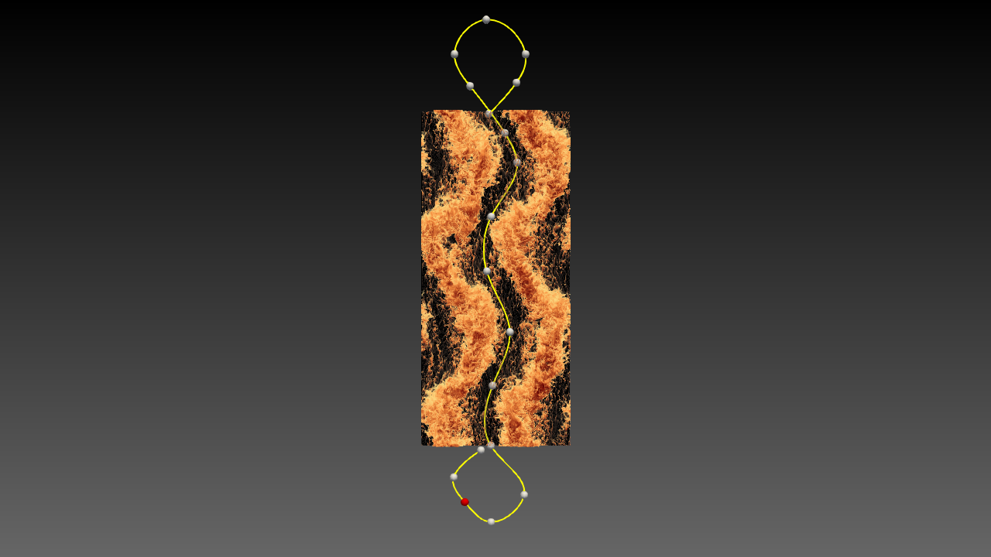
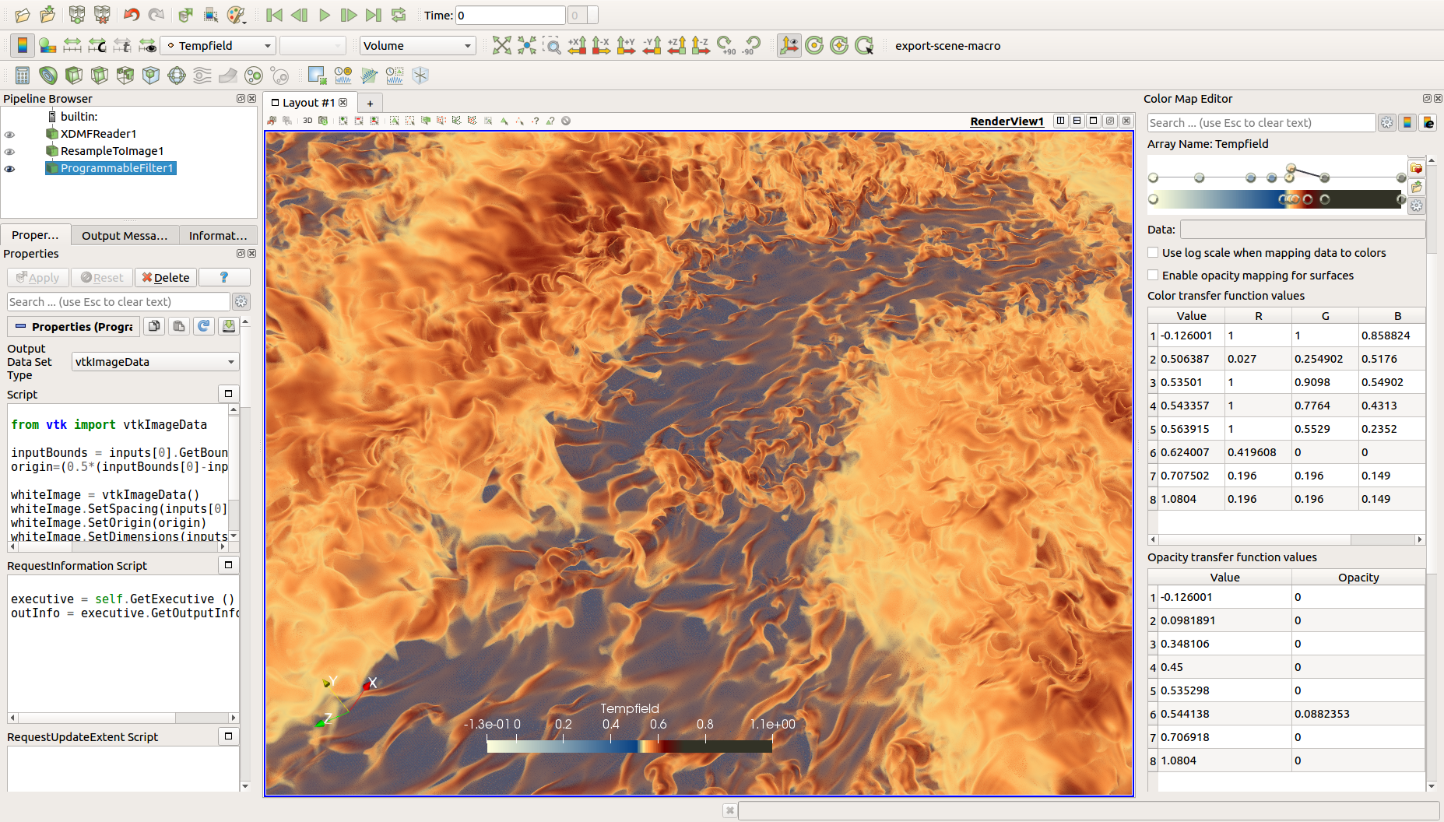
Motivational Examples

Slide 20
Summary
OpenGL is not the solution to all rendering problems
With higher scale computations, there is the need for more advanced rendering/illumination effects
A CPU-only solution can also provide performance, and can provided added features
The ParaView scripts are agnostic to the choice of hardware/software libraries. Users are supported everywhere
The landscape is constantly changing. It is our mission to test, validate, and deploy solutions as they fit our hardware (CPU and GPU).

